Slide 1
Touchworks V22 Upgrade August 28, 2023

Slide 2
Important Dates:
August 11th- System will go down (approx. 5 hours) at 7pm for a database switch
August 25th- System will go down (all weekend) at 7pm for the upgrade
August 28th- V22 Allscripts Go Live

Slide 3
Logging in: New Icon (In Clinic)
You will have a new icon on your desktop that get into Allscripts from the clinic
While on the network, you will no longer use Citrix
Accessing TW off the network will still go through Citrix

Slide 4
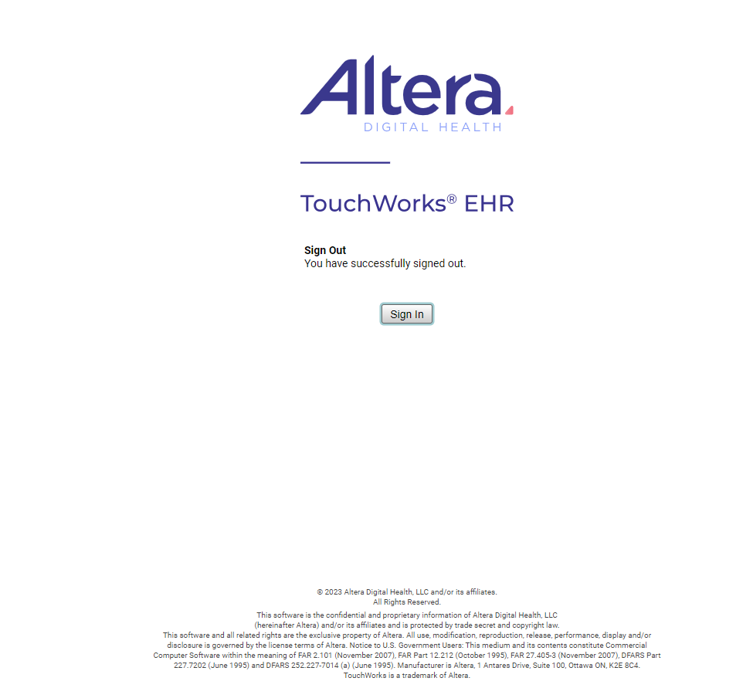
Logging in: New Icon (In Clinic)

Slide 5
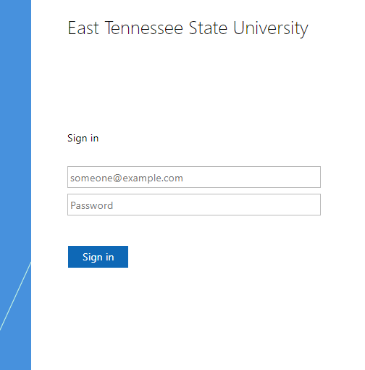
Logging in: New Icon (In Clinic)

Slide 6
Logging in: Icon (Off Network)
Mea.allscriptscloud.com

Slide 7
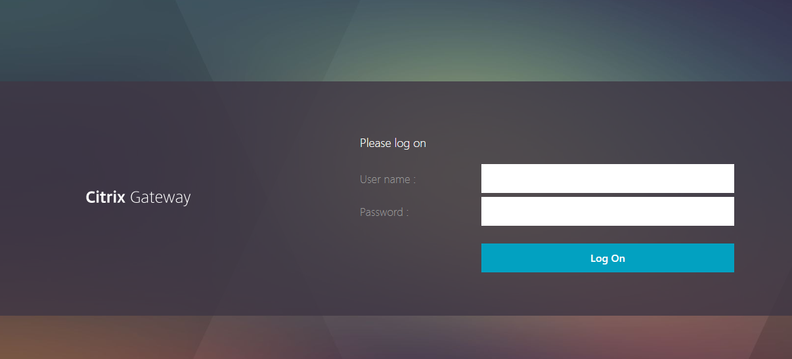
Logging in: Icon (Off Network)
Mea.allscriptscloud.com

Slide 8
Logging in: Icon (Off Network)
Mea.allscriptscloud.com

Slide 9
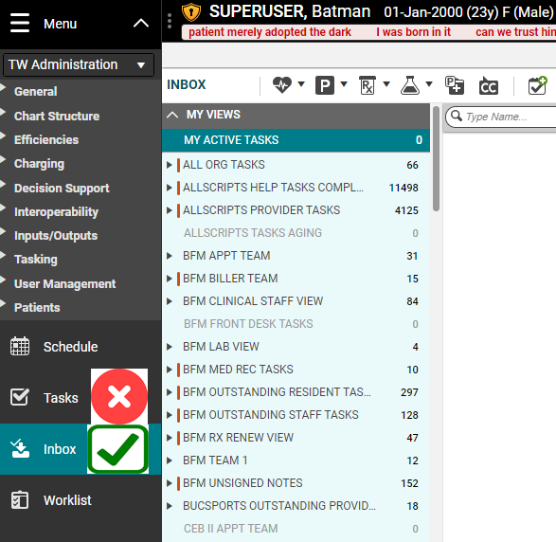
INBOX
The “tasks” section will be going away and will be replaced by “Inbox”.

Slide 10
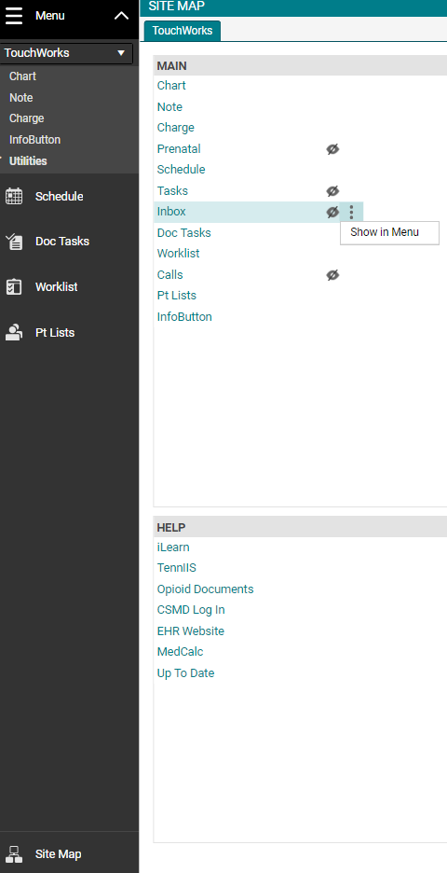
Adding INBOX
2
3
To add the Inbox, click Site Map in the bottom left of the Action Bar.
Under the MAIN menu, find Inbox.
a) Mouse over to the right of the eyeball with the cross.
b) Click the three vertical dots beside the crossed out eyeball.
4. Select Show in Menu.
4
1

Slide 11
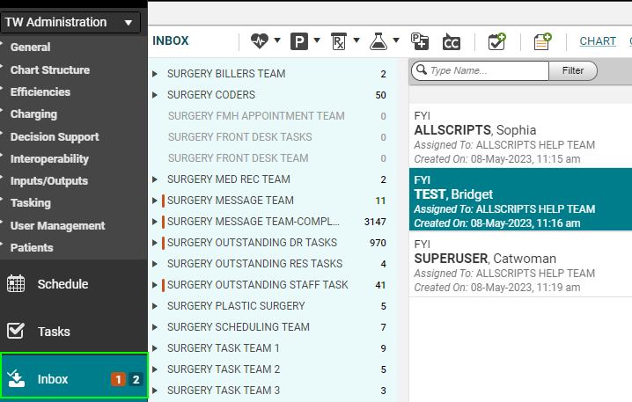
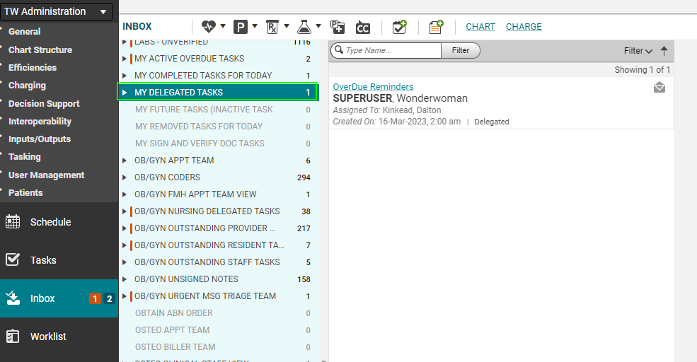
INBOX
Inbox offers a view of all task lists in conjunction with showing an active total of tasks assigned to you in your inbox.

Slide 12
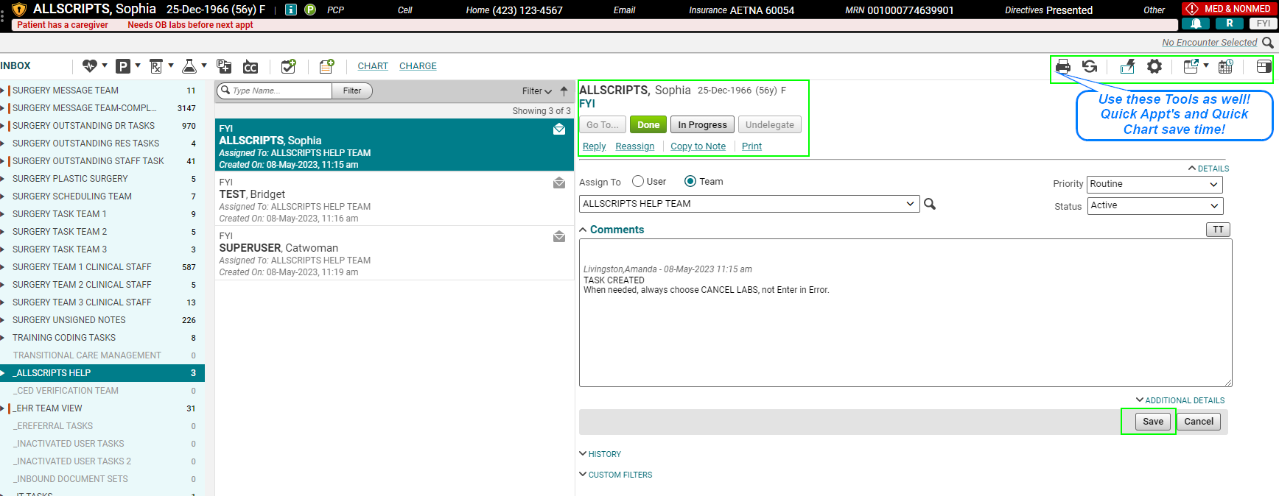
INBOX FEATURES
Inbox offers the same options/features as tasks.

Slide 13
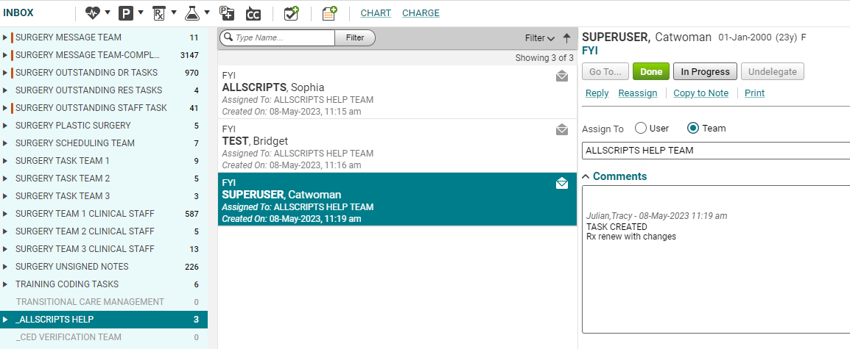
INBOX FEATURES cont.
Inbox offers the option to select multiple tasks and “done” them out at the same time so long as the tasks don’t require further action.

Slide 14
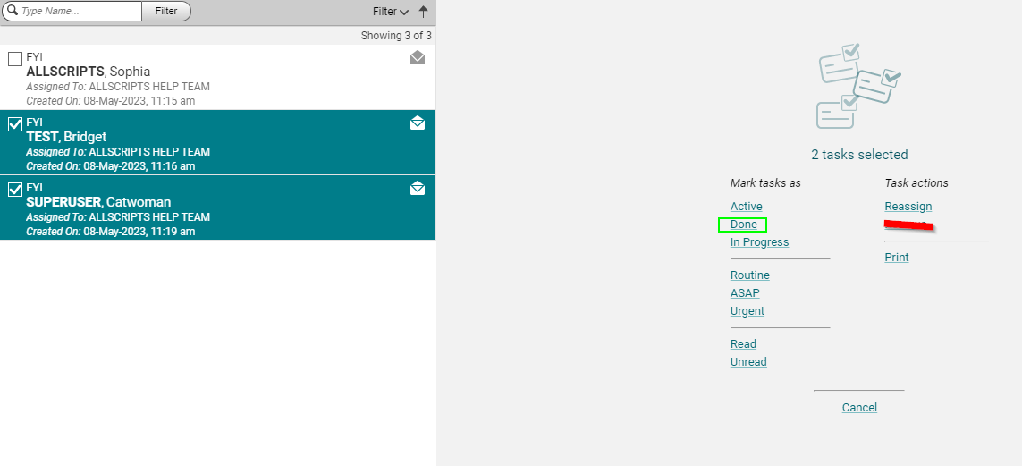
INBOX FEATURES cont.
Press and hold “shift” on your keyboard and click the message range that you would like to “done” and then press done. DON’T REMOVE TASKS.

Slide 15
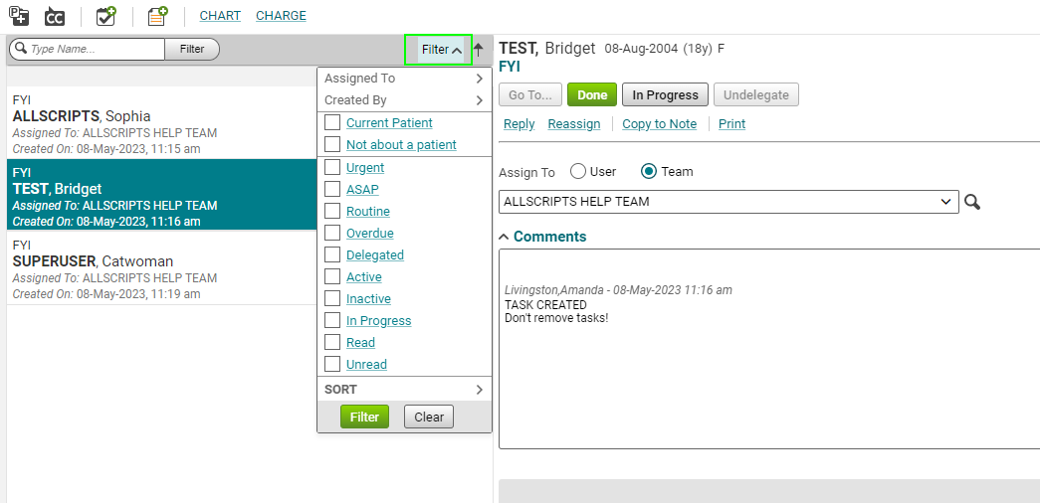
INBOX FILTERS
Set Inbox Filters by clicking on the “filter” dropdown menu.

Slide 16
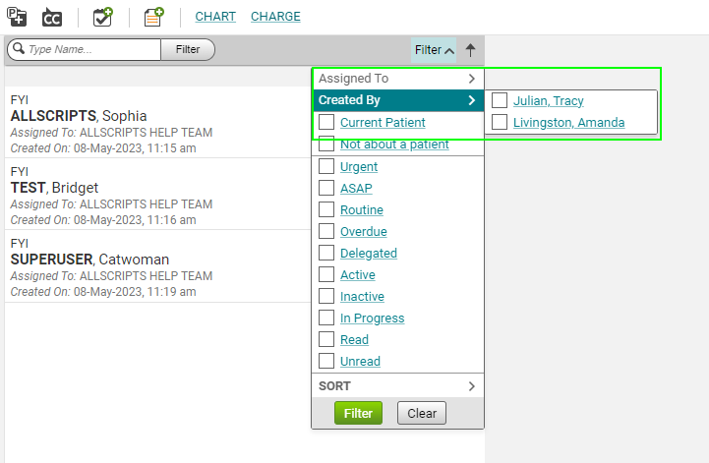
INBOX FILTERS cont.
Inbox filters are extremely useful for locating tasks assigned to/created by specific users such as nurses, residents, or preceptors.
The two options that assist in locating tasks that are tied into specific users are the “assigned to” and “created by” expandable menus in the filter section.

Slide 17
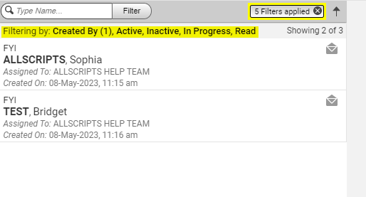
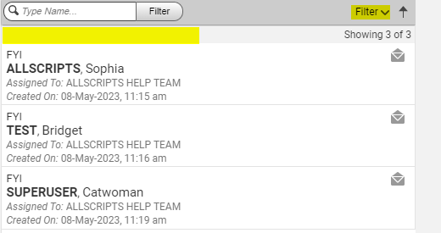
INBOX FILTERS cont.
There are also other useful filters that can be utilized to locate tasks that may be overdue or marked urgent.
REMEMBER: Once you are done using a filter, be sure to click the “x” within the filter button to restore the inbox list view to normal as to show all active tasks within the list.

Slide 18
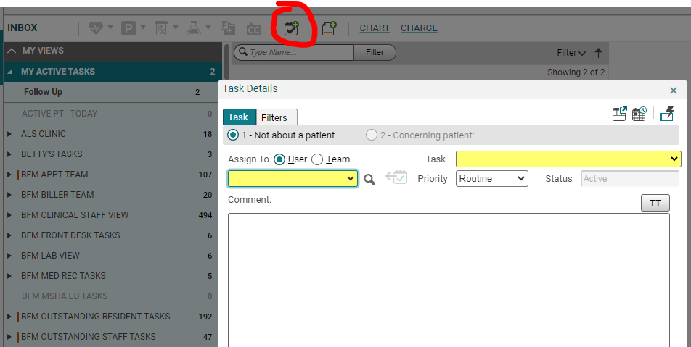
INBOX Starting a New Task
To start a new task, use the following icon which is embedded throughout EHR

Slide 19
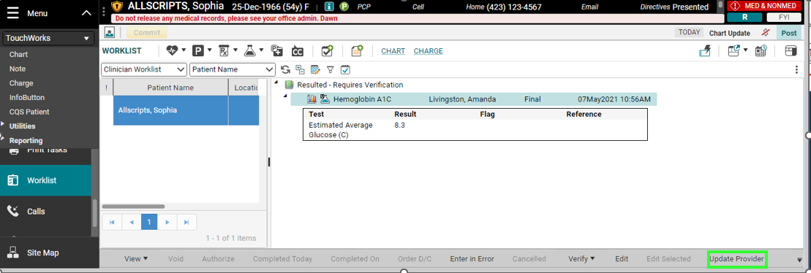
Verify Patient Results - Reassign
Changing the “verify patient results” task can no longer be done through tasks/inbox.
The work around for this process is to change it from the worklist.
Note: Precepting physicians can send verify results task to residents using this method.

Slide 20
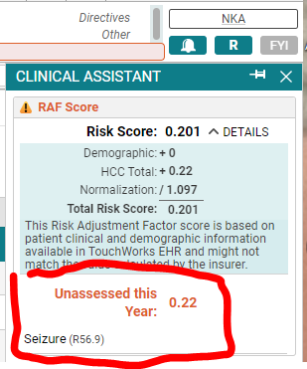
Hierarchical Condition Categories (HCC)
Bell will illuminate orange when there are HCC codes that need to be assessed this calendar year

Slide 21
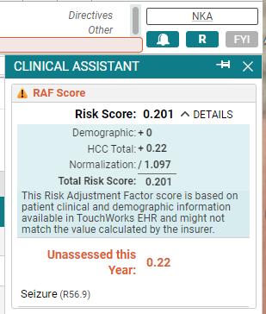
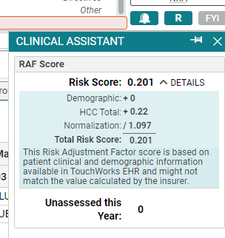
Risk Adjustment Factor (RAF) Score
The bell will have a blue dot beside it when the RAF score has not been viewed

Slide 22
CSMD/PDMP

Slide 23
CSMD/PDMP

Slide 24
CSMD/PDMP

Slide 25
CSMD/PDMP

Slide 26
CSMD/PDMP

Slide 27
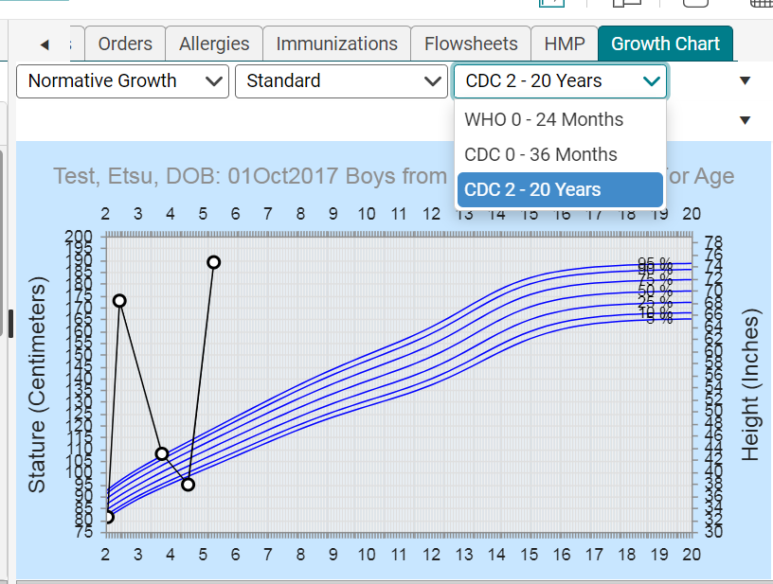
Growth Charts

Slide 28
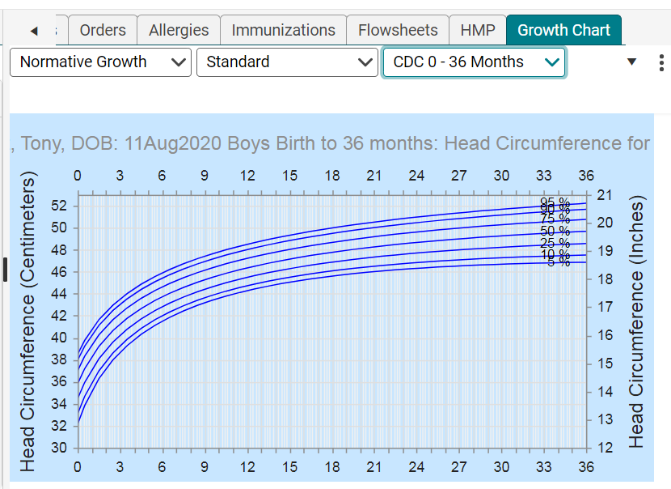
Growth Charts

Slide 29
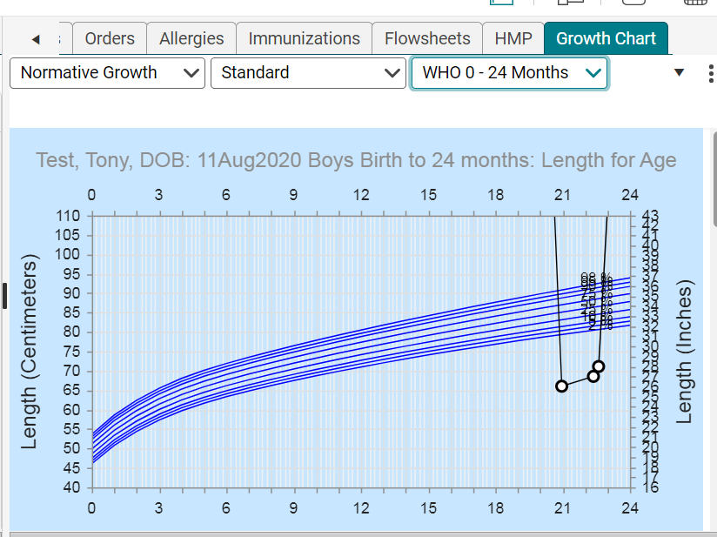
Growth Charts

Slide 30
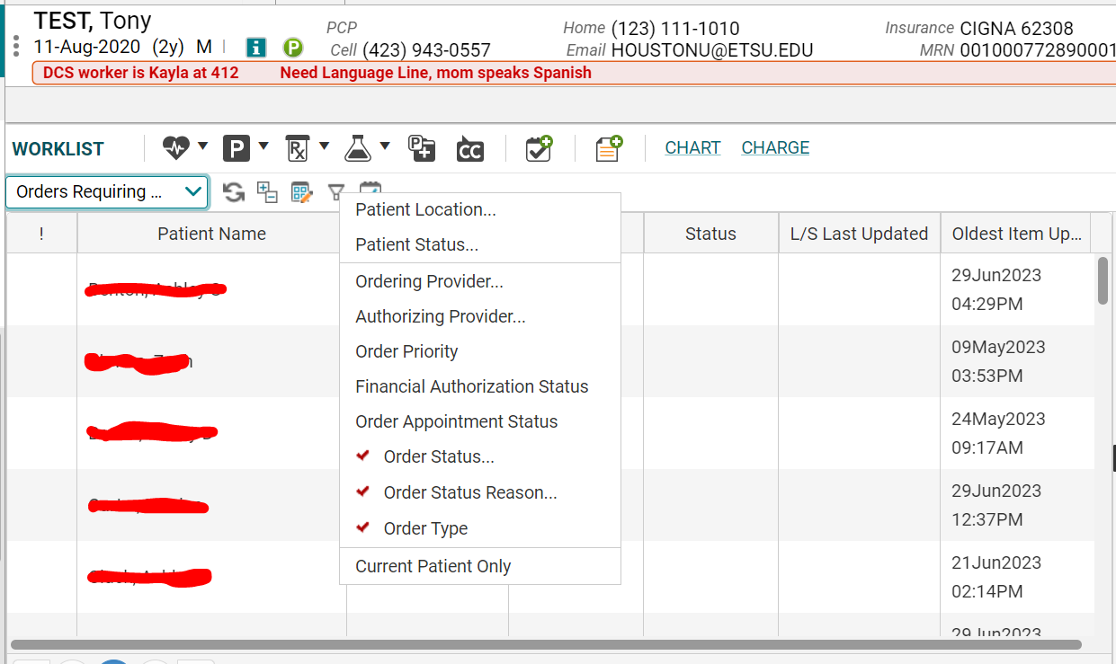
Worklist Changes
Can now filter by Financial Authorization status as well as Order Appointment Status, Expand Date filters

Slide 31
Worklist Changes
We now have a To Be Done Column

Slide 32
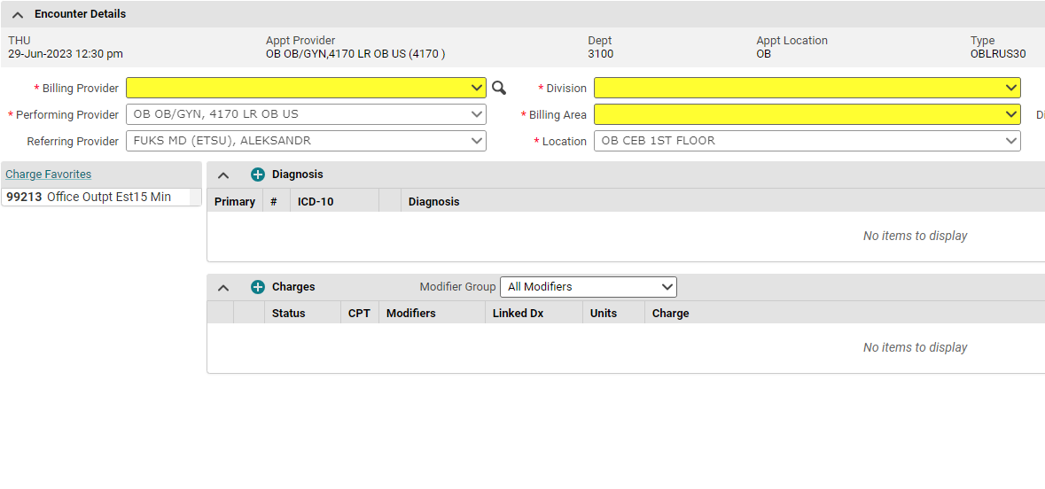
Charge Changes
Charge Favorites Panel has been added to the left side

Slide 33
MISC. Changes
Removed Changed to EIE
EIE Tasks CANNOT be reactivated or undone
DO NOT EIE tasks, send to the Allscripts Help Team

Slide 34
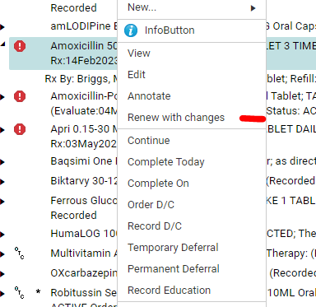
MISC. Changes
Can No Longer Just Renew
Can only Renew With Changes

Slide 35
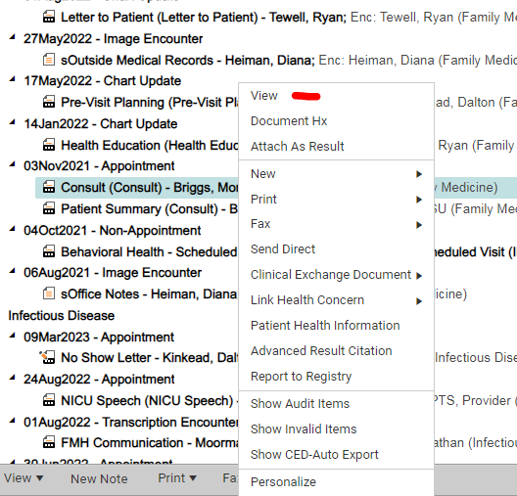
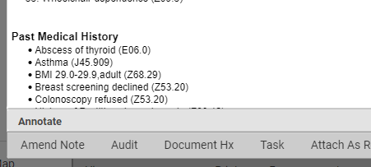
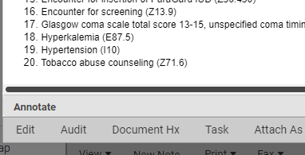
MISC. Changes
Can No Longer Right Click and Edit Notes
Now you have to right click, view, and then edit or Amend Note

Slide 36
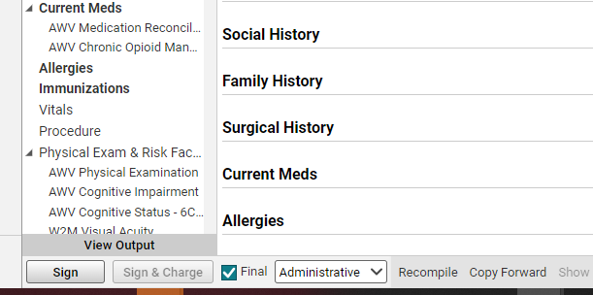
MISC. Changes
Now have Sign and Sign and Charge in the Edit mode of the Note

Slide 37
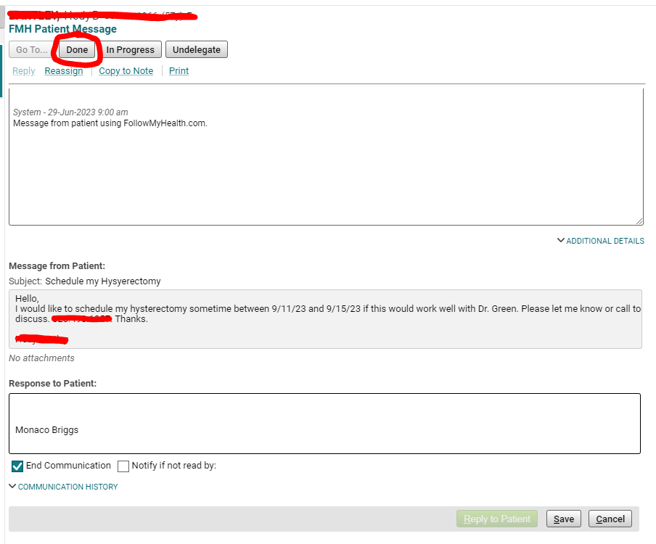
MISC. Changes
You can now DONE a FMH Patient Message without sending a response to the patient

Slide 38
EHR Update/Tasks
As a reminder: We will be moving to Version 22 of Touchworks on August 28th, this is a required update to be compliant with the Cures Act.
The biggest notable visible update that we are aware of is the shift from the “tasks” section to the “Inbox” section as the standard way of working tasks.
With this change, you will notice that some task lists may have many unworked tasks. It is imperative that we begin working on and completing these tasks as we are looking to move to Epic sometime next year, date TBD. We do not want to leave important messages concerning our patients behind in Touchworks as we navigate towards a better system.

Slide 39
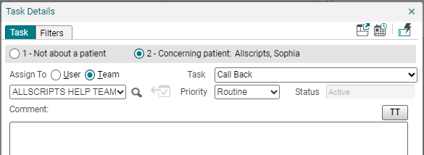
Conclusion
Feel free to call the EHR help desk if you have any questions. 423-282-6122 Option 1.
Look for other useful tips and tricks/How to Documents on our website, https://www.quillenphysiciansehr.com/
Keep an eye out for email correspondence from our team, we send weekly tips and tricks and other useful information that helps our users navigate the EHR system.
Never Enter in Error a task. EVER. Send to helpdesk at Allscripts Help Team

